Slide 1
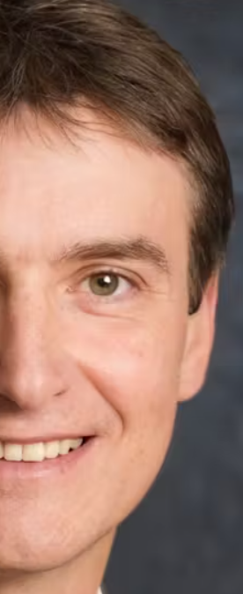

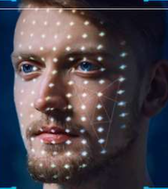
By YASH KHATRI JAINAM SHAH

Slide 2


Problem Statement
Developing an AI-Powered Media
Authenticity Verification App

Slide 3
Introduction
Training Workflow
01
06
Prediction Workflow
System Architecture
07
02
Dataset Exploration
Tools and Technologies
03
08
Pre-processing
09
Results
04
Model Architecture
10
Demo
05

Slide 4
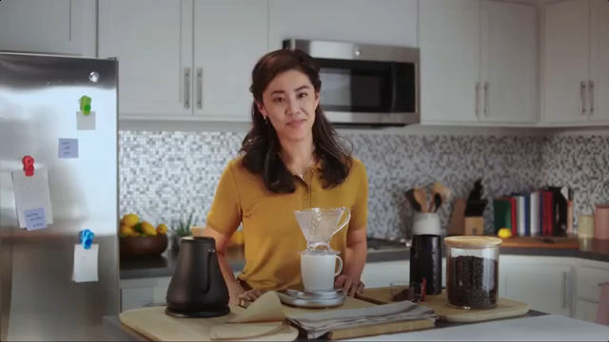
Introduction
Deep fake is a technique for human image synthesis based on artificial intelligence.
Deep fakes are created by combing and superimposing existing images and videos onto source images or videos using a deep learning technique known as generative adversarial network.

Slide 5
Can we detect Deep fakes with naked eyes?

Slide 6
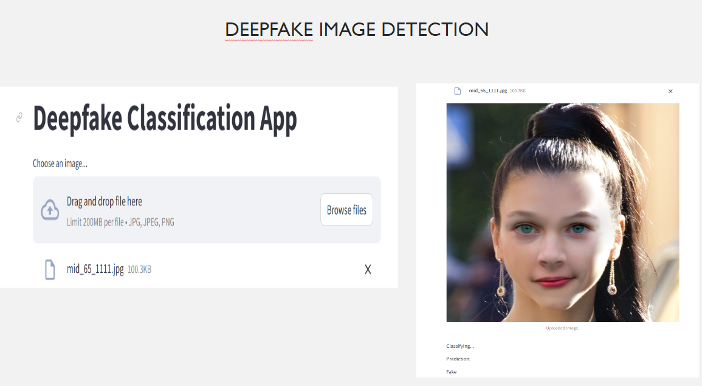

Slide 7
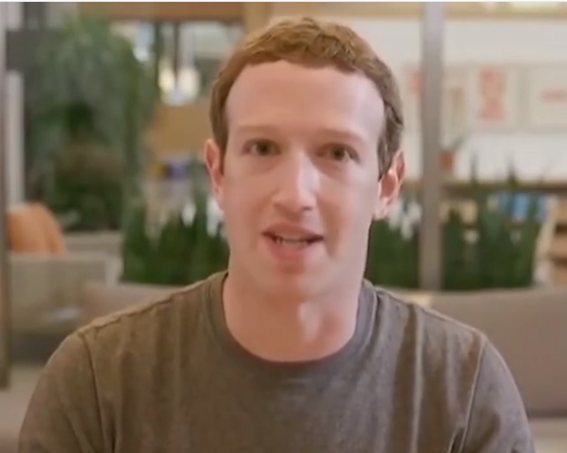
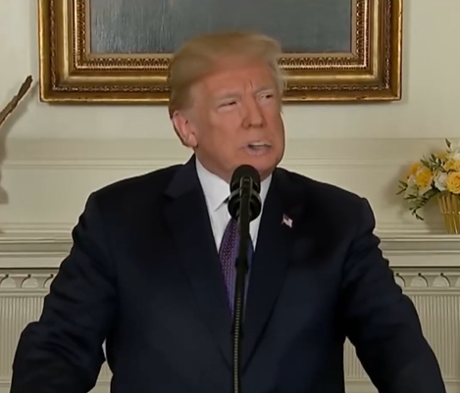
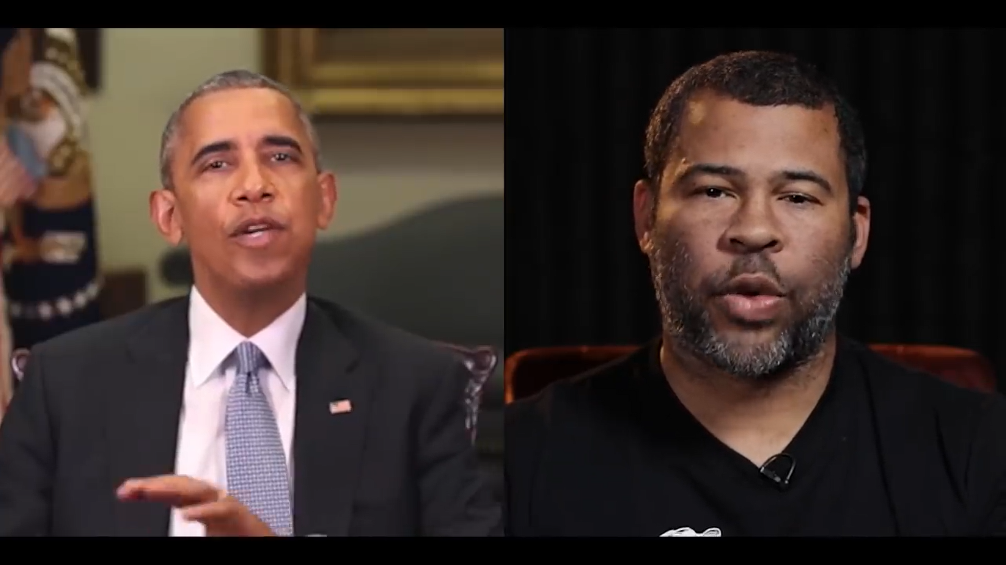
Why Deep Fake Detection ?
Fake News
Malicious hoaxes
Financial fraud
Celebrity unusual video
Politician videos

Slide 8
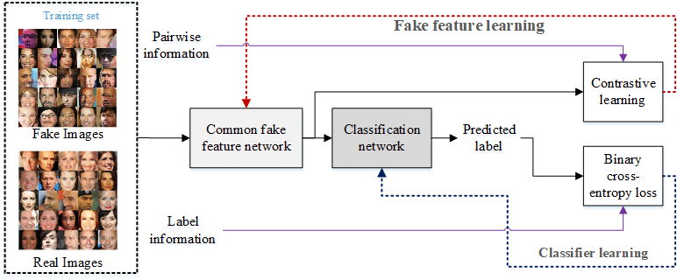

System Architecture

Slide 9
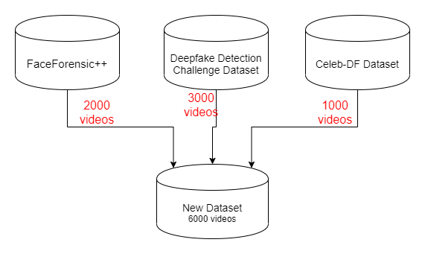
Data-set Exploration
images
images
images

Slide 10

Pre-processing
SPLIT VIDEO INTO FRAMES
FACE DETECTION
5
4
3
2
1
CROPING FACE
CREATING NEW FACE CROPPED image
SAVING THE FACE CROPPED image

Slide 11
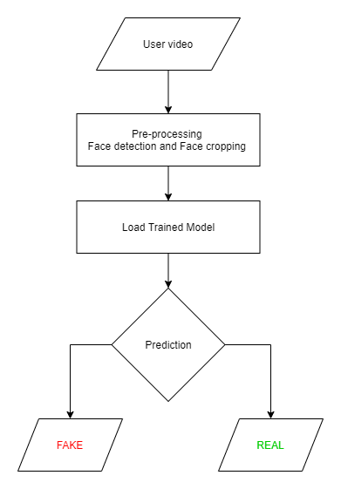
Prediction Workflow
IMAGE

Slide 12











Programming Languages
Python3
Programming Frameworks
Tensorflow
STREAMLIT
Tools and Technologies
IDE
Google
Jupyter Notebook
Visual Studio Code
ALGORITHMS
Logistic Regression
Version Control
Git

Slide 13
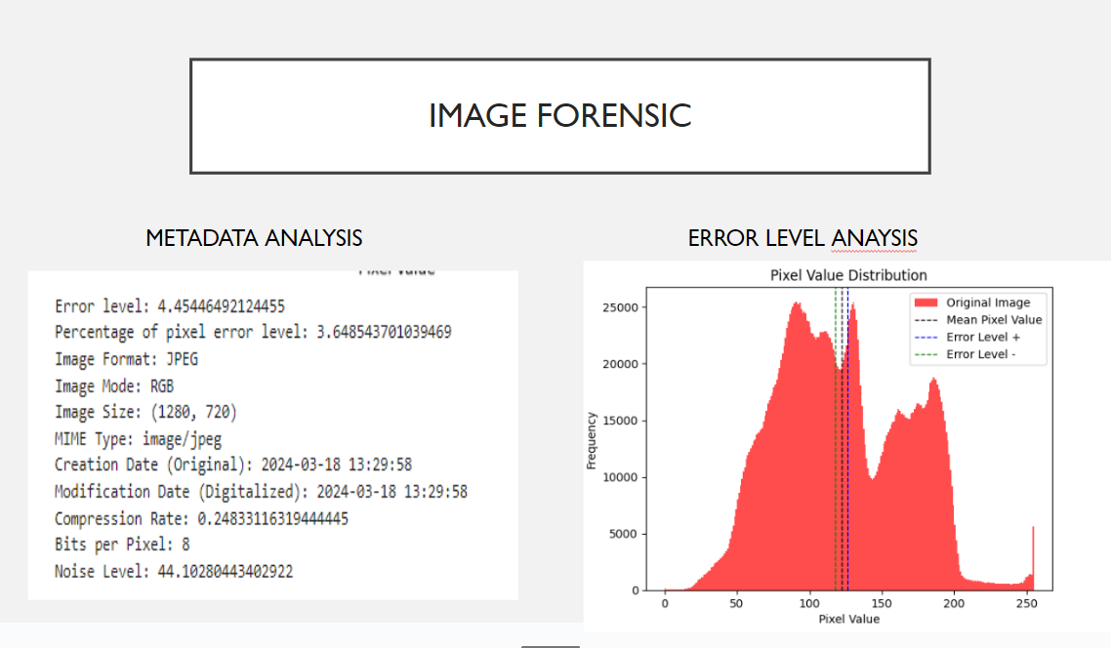
Results
ANALYSIS

Slide 14


Slide 15


